Slide 1


Customer Segmentation & Recommendations
This project combines customer segmentation and recommendation systems to improve customer engagement and sales, utilizing data analytics to identify distinct customer groups and provide personalized recommendations.

Slide 2
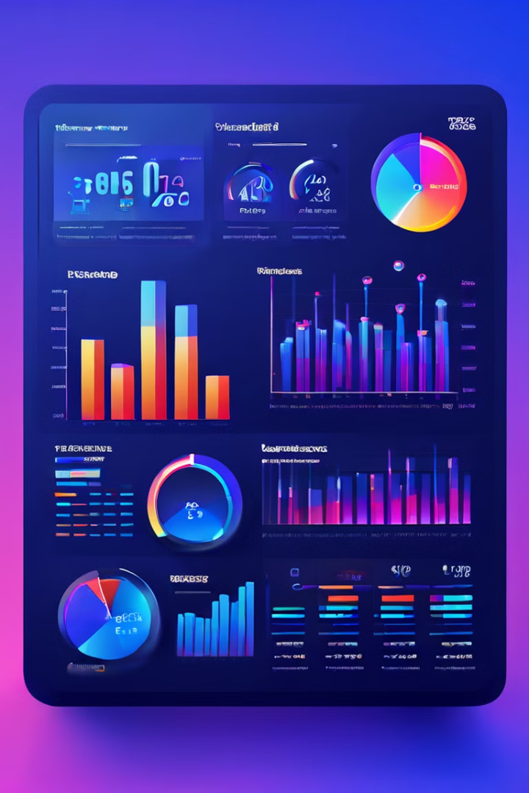
Dataset Overview
1
Key Features
2000+ records with customer demographics and purchasing behavior, including attributes like CustomerID, Gender, Age, Annual Income, and Spending Score.
2
Importance
Provides insights into customer behavior, forming the basis for segmentation and recommendation tasks.

Slide 3
Exploratory Data Analysis (EDA)
Objective
Key Insights
Analyze data to uncover patterns in demographics and spending habits.
Significant correlation between age, income, and spending score; identification of high-spending customer clusters.

Slide 4

Data Preprocessing
Cleaning and Preparation
Feature Engineering
Handled missing values and removed outliers for consistent analysis.
Normalized data to facilitate effective clustering and recommendations.

Slide 5
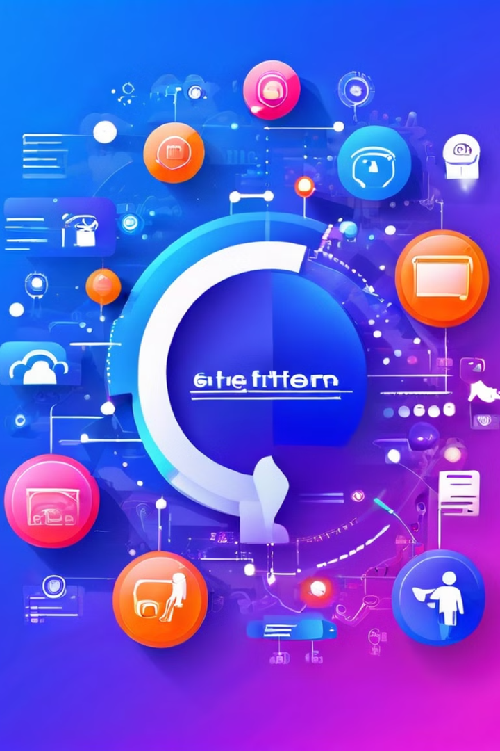
Understanding Customer Segmentation
1
Concept
Segment customers based on similarities to tailor marketing efforts effectively.
2
Benefits
Improved targeting and personalized marketing; enhanced understanding of customer needs and preferences.

Slide 6
Segmentation Techniques Used
Algorithm Choice
Advantages
Implemented K-means Clustering to group customers based on demographic and behavioral data.
Simple, effective, and widely used for identifying customer groups.

Slide 7

Implementing K-means Clustering
1
Steps Taken
Normalized dataset features and used the Elbow Method to determine the optimal number of clusters.
2
Execution
Applied K-means to identify five key customer segments, visualized with scatter plots.
3
Results
Clear differentiation of customer groups, enabling targeted marketing strategies.

Slide 8

Introduction to Recommendation Systems
Purpose
Approaches
Deliver personalized product recommendations to enhance customer experience.
Collaborative Filtering and Content-Based Filtering, with a focus on collaborative filtering in this project.

Slide 9



Recommendation Algorithm Selection
Collaborative Filtering
Leverages historical interaction data to predict preferences.
Justification
Chosen for its effectiveness in handling sparse datasets.

Slide 10
Model Evaluation and Results
Evaluation Metrics
Findings
RMSE and MAE used to assess recommendation accuracy, and Silhouette scores evaluated segmentation quality.
Recommendations align closely with user preferences, enhancing engagement, and segmentation results in well-defined customer groups.

Slide 11
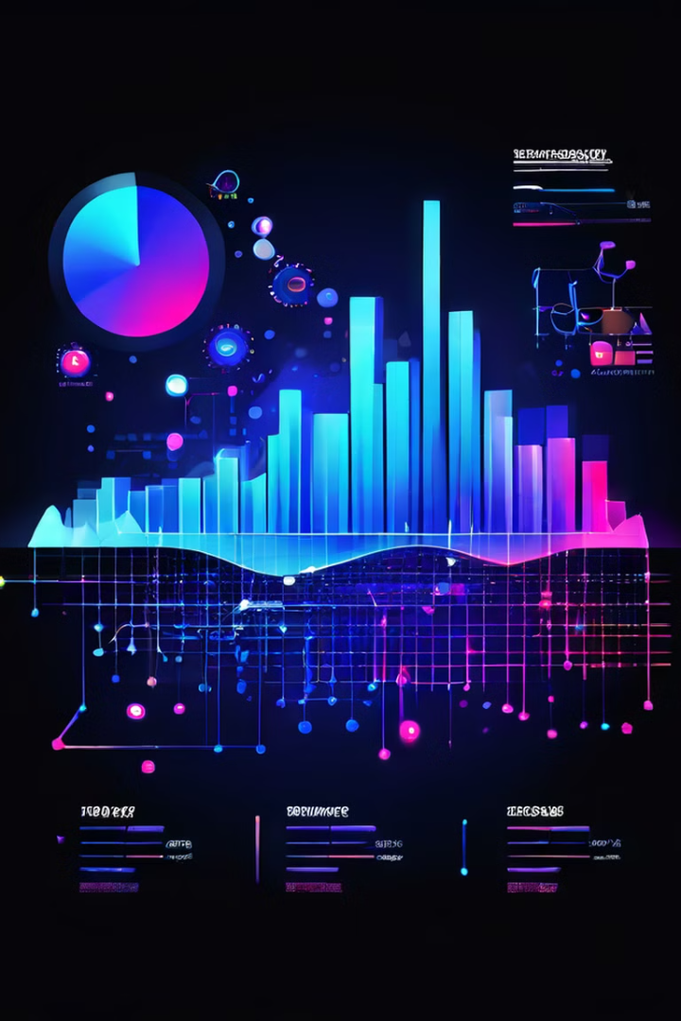
Integration of Segmentation and Recommendation
Synergy:
Segmentation refines recommendations by tailoring them to customer groups.
Impact:
Personalized suggestions increase customer satisfaction and sales.
Business Implications:
Drives targeted marketing, boosts ROI, and improves customer retention.

Slide 12
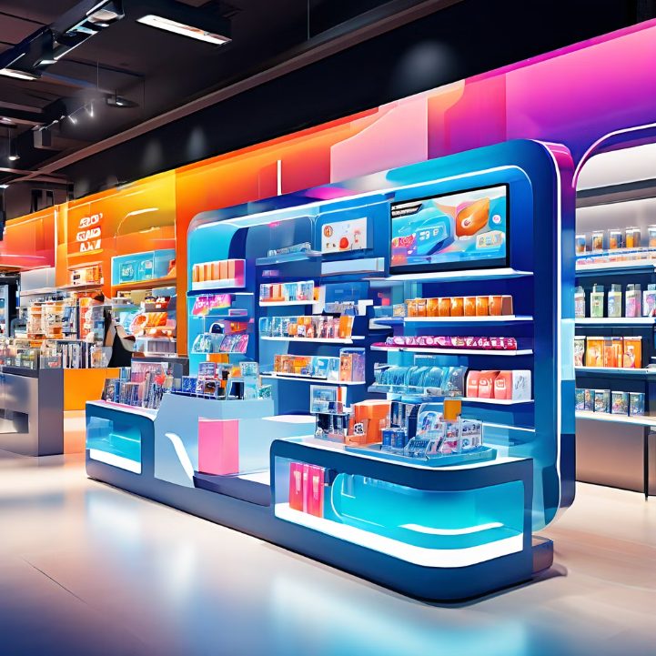
Applications and Benefits
Real-World Applications:
Used by retailers and e-commerce platforms to deliver personalized experiences.
Retail Impact:
Enhances customer satisfaction through relevant offers.
Optimizes inventory by predicting customer demand.
Business Benefits:
Increases efficiency and boosts revenue through targeted campaigns.

Slide 13

Conclusion
Summary:
Successful implementation of segmentation and recommendation systems.
Final Thoughts:
Data-driven strategies are crucial for customer insights and engagement.

Slide 14
GROUP 4
G VARSHITH REDDY
G RAKSHITHA REDDY
DHANUSH KARTHIKEYA AJ
ISHAM SINHA
ANITHA RANI

